Slide 1

AJAX-3
SHARMA COMPUTER ACADEMY

Slide 2
What is an api ?
API is the acronym for Application Programming Interface.
It is a software intermediary that allows two applications to talk to each other.
In simple terms an API is defined as a code that helps two different software’s to communicate and exchange data with each other.

Slide 3
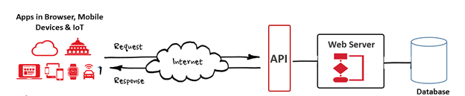
What is an api ?

Slide 4
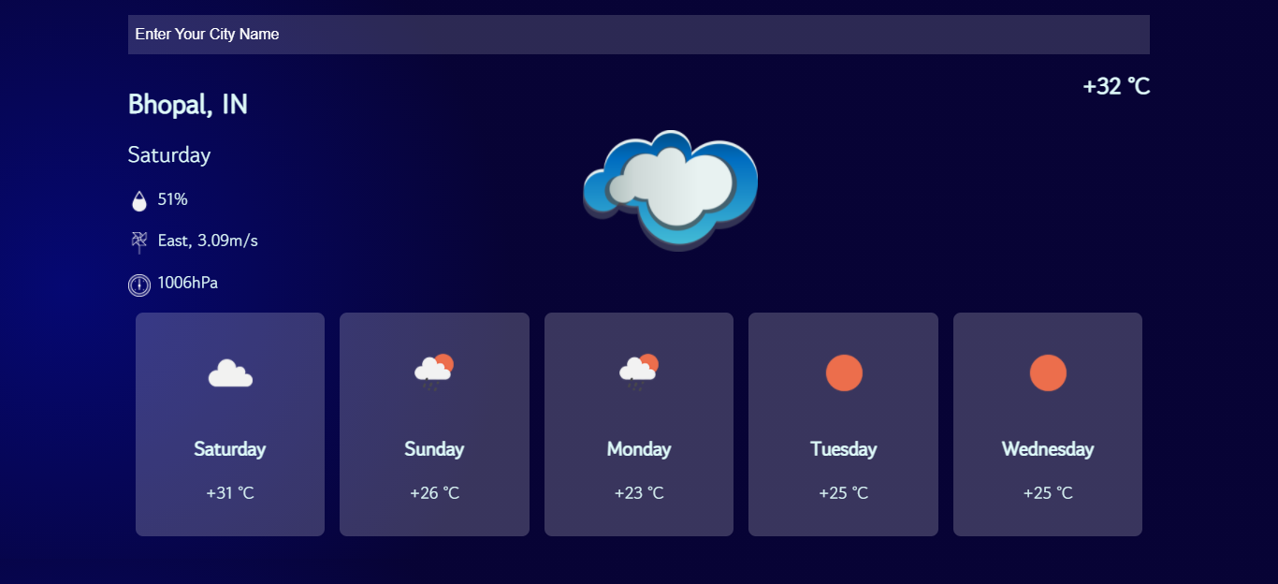
Examples of api
Weather Apps

Slide 5
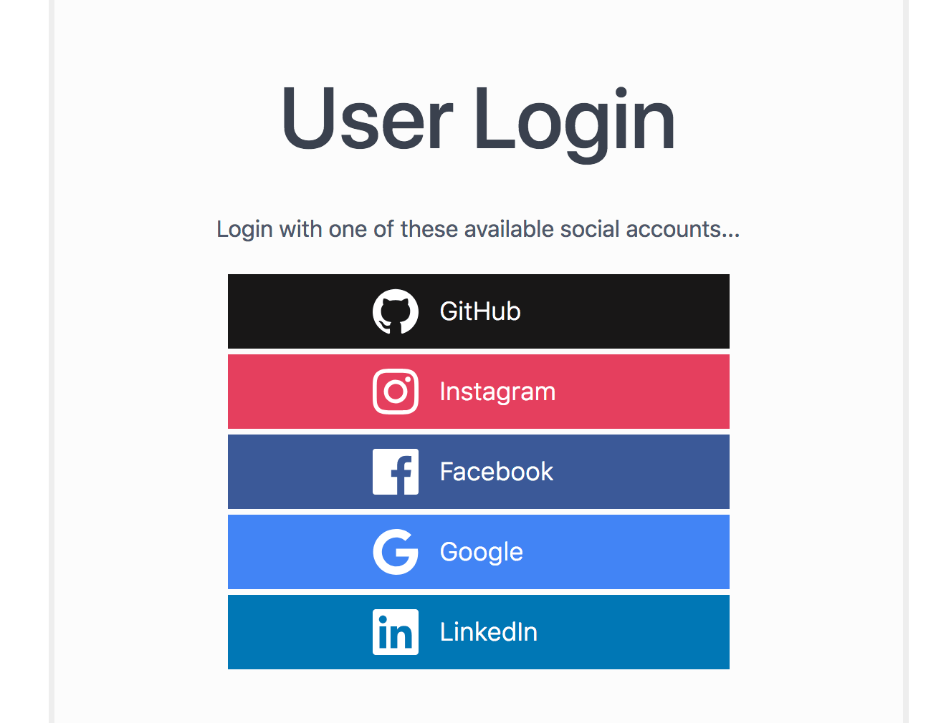
Examples of api
Login API

Slide 6
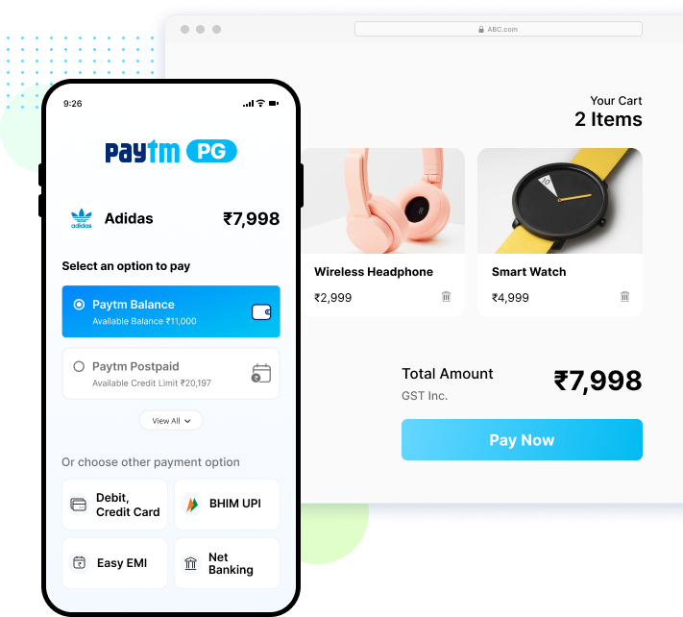
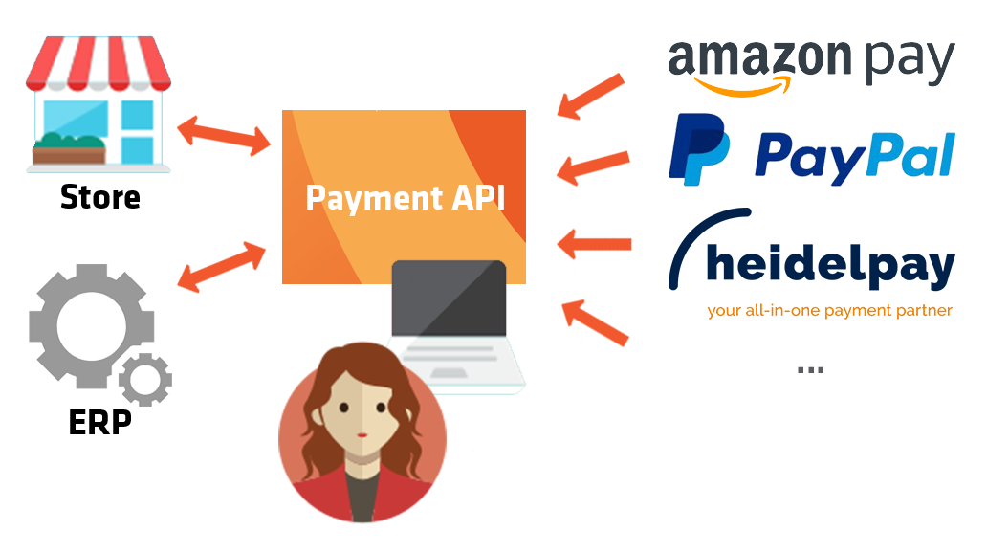
Examples of api
Payment Gateway API

Slide 7
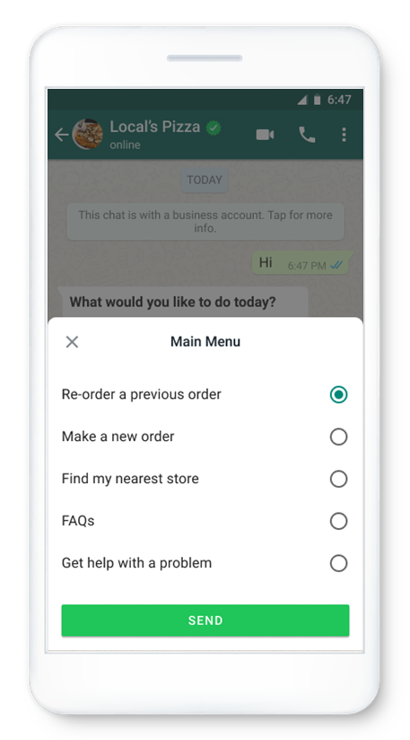
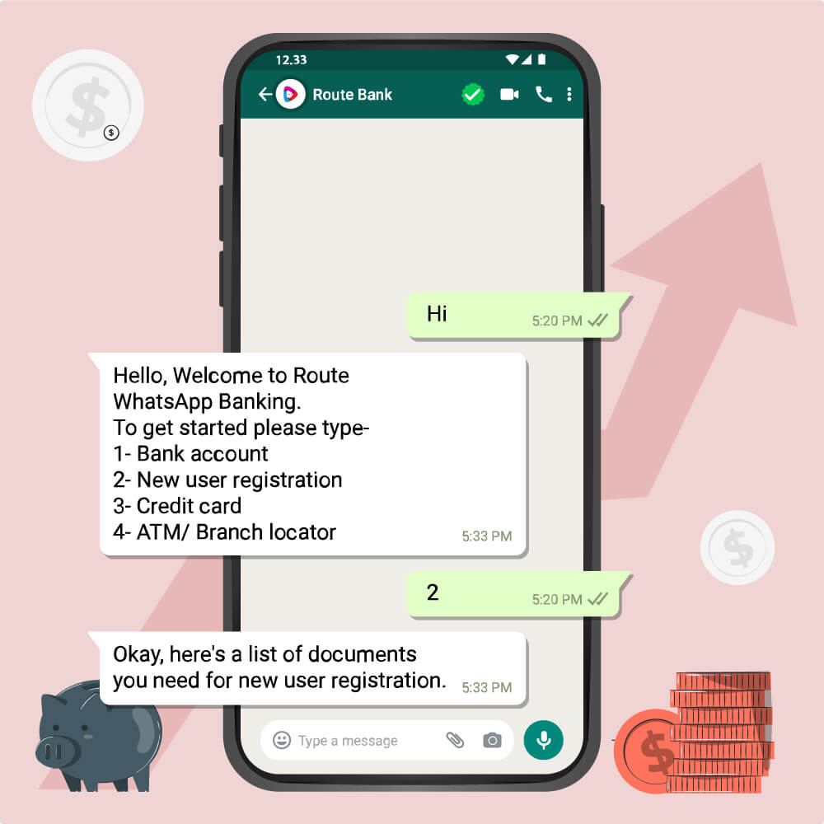
Examples of api
WhatsAPP Business API

Slide 8
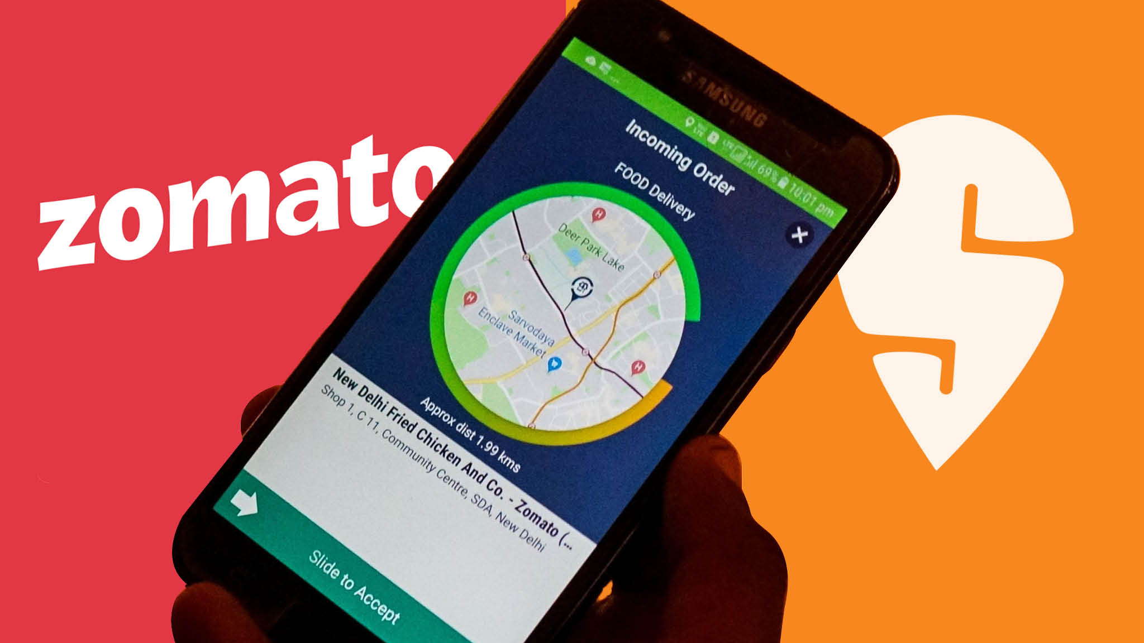
Examples of api
Google API Used By Food Delivery Apps

Slide 9
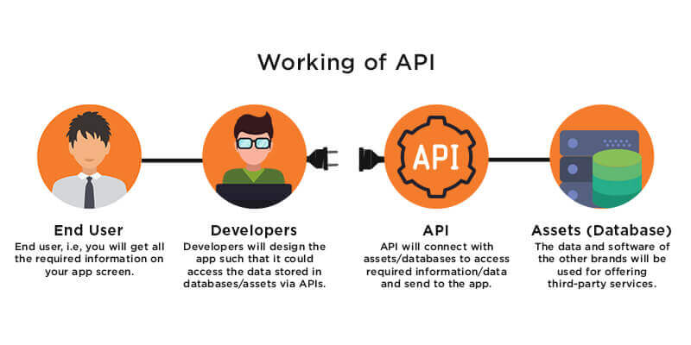
How does an api work ?

Slide 10
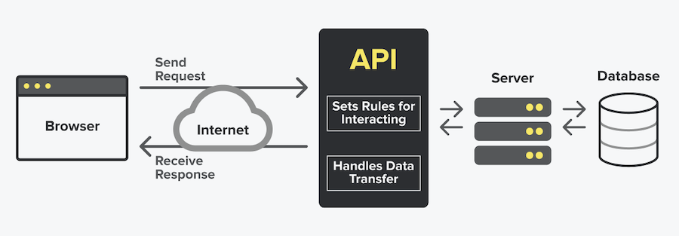
How does an api work ?

Slide 11
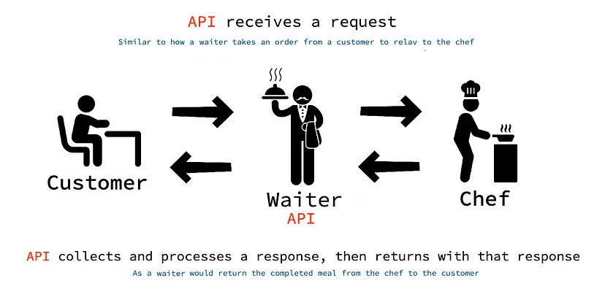
A real life example

Slide 12
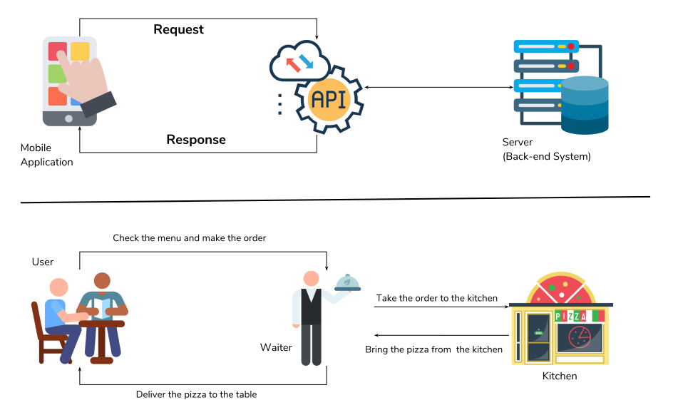
A real life example

Slide 13
A real life example
Imagine you go to a Pizza restaurant.
You check the menu and place the order.
This order needs to be sent to the kitchen.
Hence, you place the order through a waiter.
The waiter takes your order to the kitchen and brings back your pizza from the kitchen.

Slide 14
A real life example
In this example:
The menu is your application.
You are sending request by placing your order.
Waiter act as the API which is the intermediary who takes your request to the kitchen — the back-end system.
You get the pizza or the response from the kitchen through the waiter or the API.

Slide 15
Api terminologies
Functions | API | Meaning | Example
Name Of Function | End Points | The end point is typically the address or the URL, which points to the API. | http://worldtimeapi.org/api https://www,swiggy.com/dapi/cart
Arguments | Request Payload | The data passed to the API so that it can process it and return us some meaningful result | { "Id": 78912, "Customer": “Rajesh Verma" }
Return Value | Response | The results returned back by the APIand this is generally in the form of JSON. | { "success": "true", "data": { "TotalOrders": 100 } }

Slide 16
Exercise 4
Write an AJAX based application to do the
following:
As soon as the page loads , pull all the timezones available from the api end point: http://worldtimeapi.org/api/timezone
Now when the user selects a timezone and clicks the button thenr display its current date and time using the api end point: http://worldtimeapi.org/api/timezone/<timezonename>

Slide 17
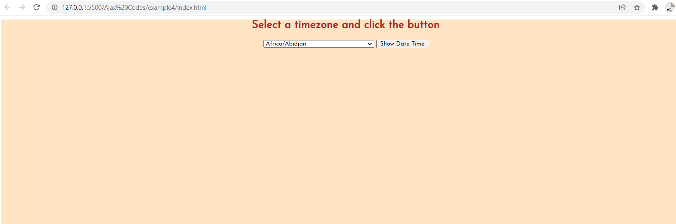
Desired output

Slide 18
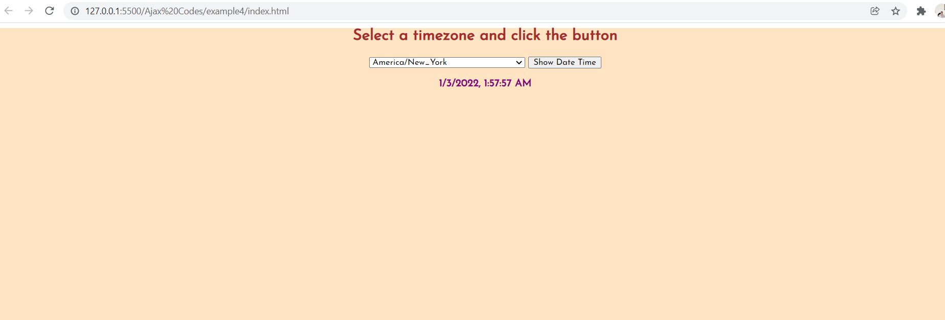
Desired output

Slide 19
PROJECT
Write an AJAX based application to do the following:
Provide a button to the user and when the user clicks it pull all the country names available from the api end point: https://restcountries.com/v2/all
Now as soon as the user selects a country display three details about that country:
Capital City Name
Flag Image
Currency Name

Slide 20

Desired output

Slide 21

Desired output

Slide 22
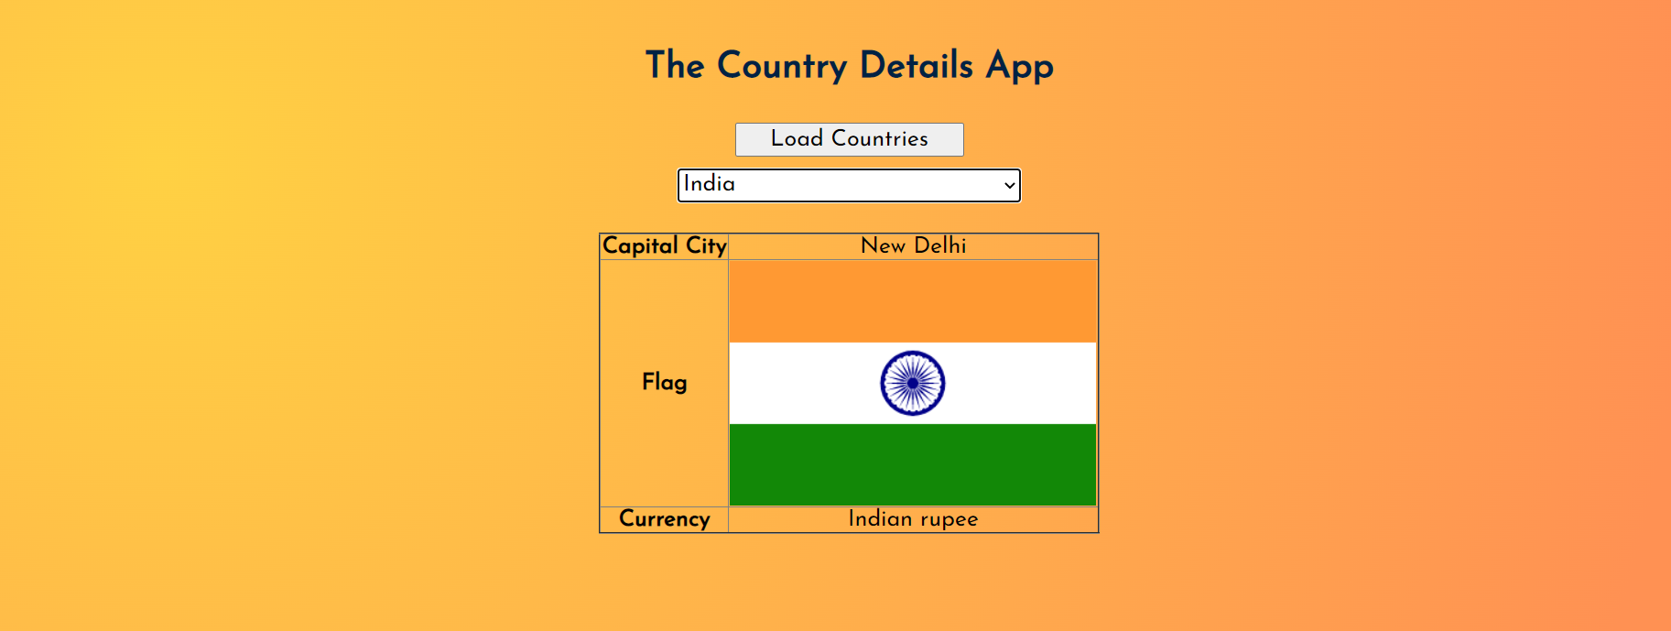
Desired output

Slide 23
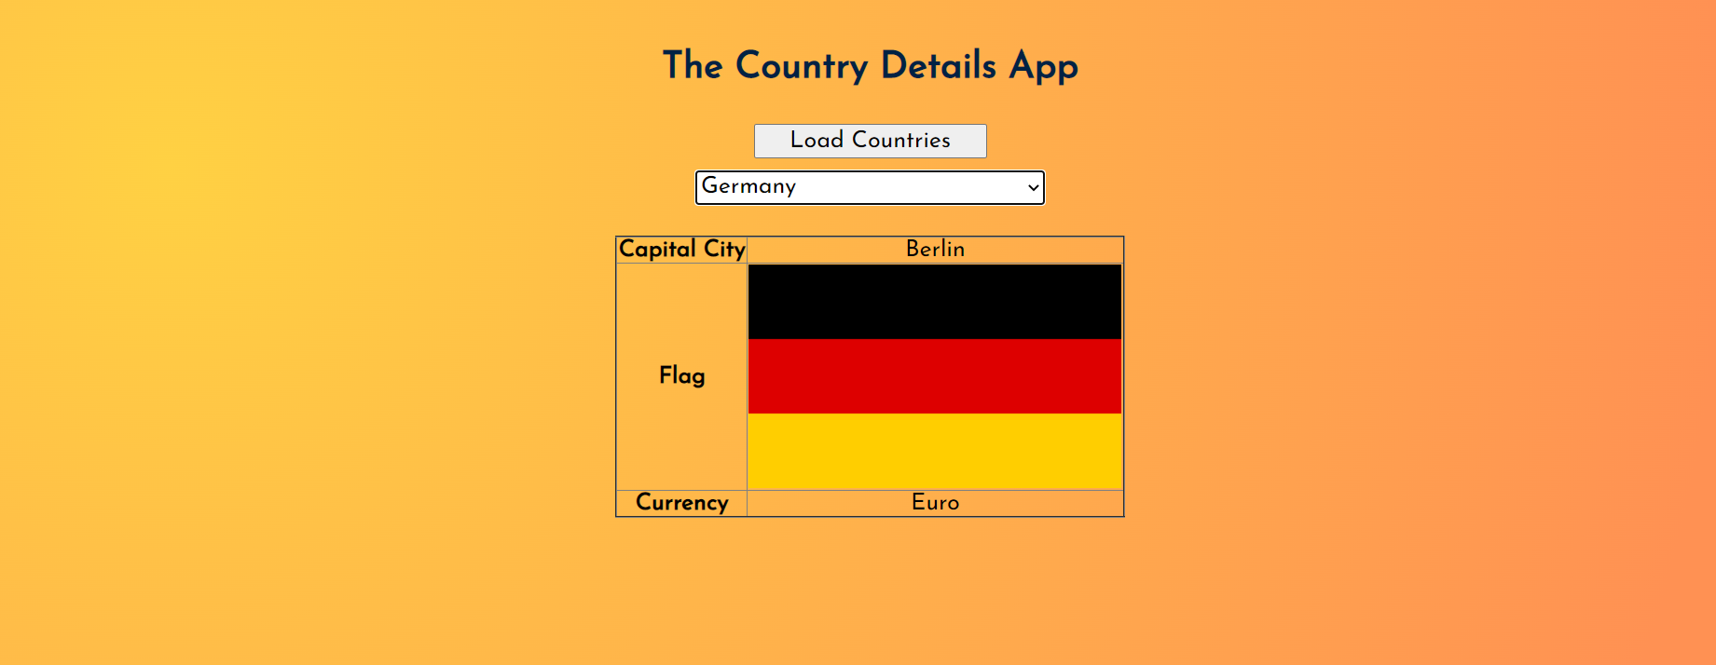
Desired output

Slide 24

Thanks!
Any questions?
You can find me at:
Email id: info@scalive.in
Contact no. : +917314853128

